Slide 1
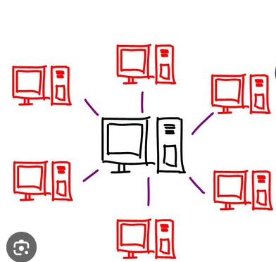

Functional Choregraphies in Lean4
Master Thesis (due 01.05.24)

Slide 2

Choreographic programming

Slide 3
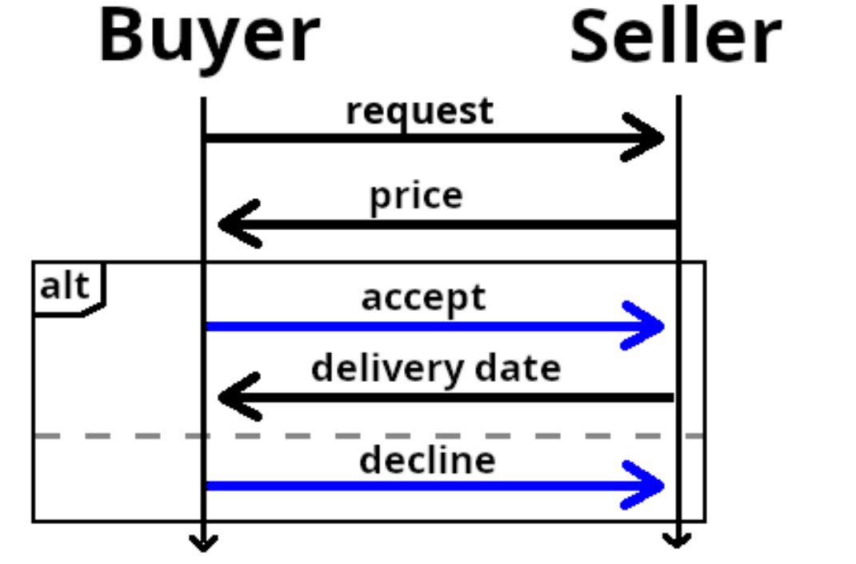
Simple Bookseller Protocoll

Slide 4
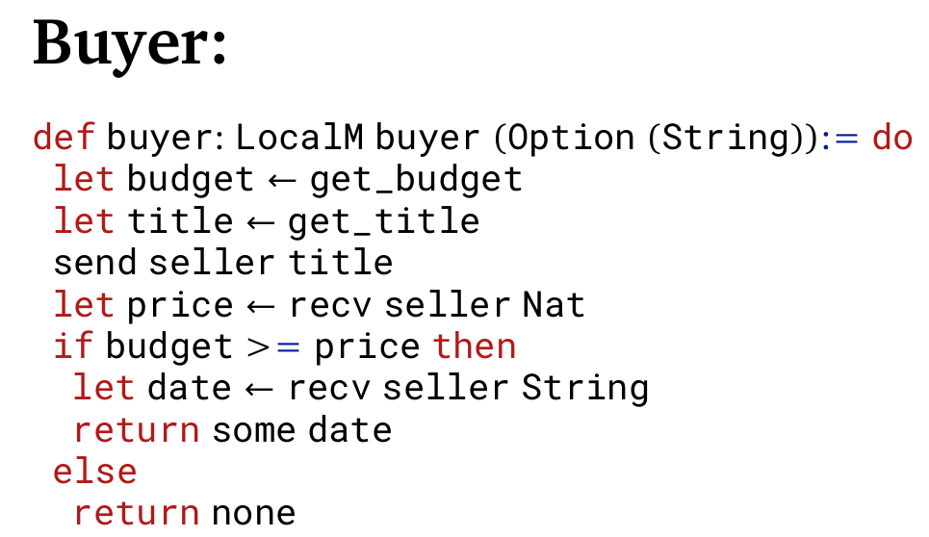
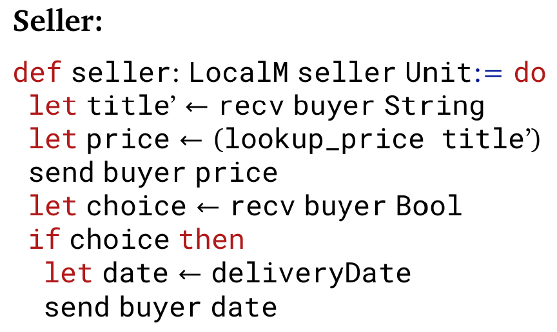
Local Programs

Slide 5
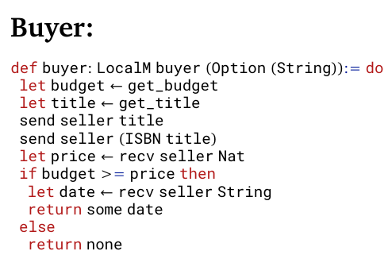
Local Programs

Slide 6
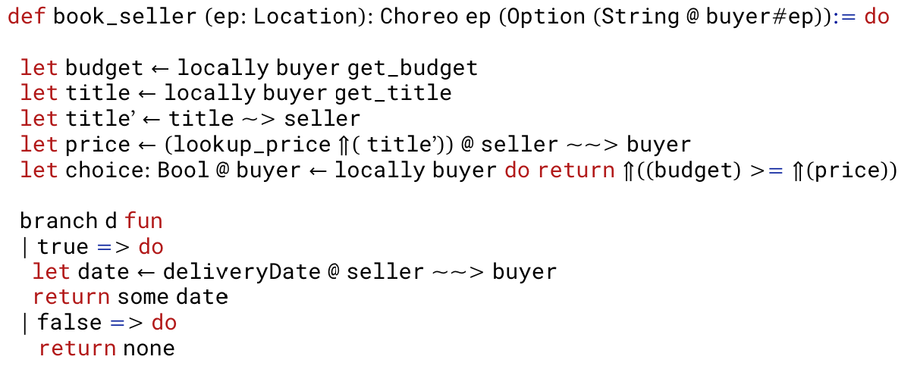
Choreographic Approach

Slide 7
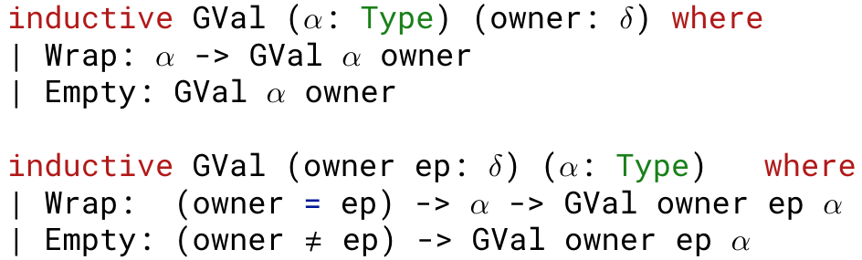
Own Contributions
Include enpoints into the type system

Slide 8
Own Contributions
Locations as finite sets: less unsafe checks for locations at runtime
Locally dependent monadic programs: other implementations are parameterized over the locally executable for all locations
seamless integration of EPP into IO programs through MonadLifting

Slide 9
Example Implementations
Bookseller with higher order Choreos and location polymorphism
Distributed Mergesort with variable amount of compute nodes
Simple SSO authentication protocol

Slide 10
Danke für eure Aufmerksamkeit !

